Slide 1
Occupational Health and Safety
-
A vital issue for workers and trade unions in capital cities
Viktor Kempa, Senior Researcher
ETUI Working Conditions, Health and Safety Unit

Slide 2
Most buring issues in OHS
WORLDWIDE
More than 340 million accidents each year
More than 360 000 fatal accidents each year
2.4 million deaths because of harmful working conditions annually

Slide 3
Most buring issues in OHS
More than 100,000 people still die every year from work-related cancer in EU
No real improvement in numbers of fatal workplace accidents
There is a rocket increase in PSRs related diseases in the EU
The number of OHS field labour inspectors is cut in more than 50% in last 10 years
Many of the over 1 million victims of Covid-19 in Europe contracted the disease at work

Slide 4
Content:
1. EU OHS Strategic Framework 2021-2027
2. EU-OSHA ESENER 2019 edition

Slide 5
Timeline of EU OHS

Slide 6
After 2020 …
Communication = a tool for contact and inform people about EU issues
SF = Comission Policy document
Defines the key priorities and actions for improving workers’ health and safety, addressing rapid changes in the economy, demography and work patterns.

Slide 7
EU Strategic Framework in OHS 2021 – 2027
Start from: Conclusion
SF aims at mobilising EU institutions, MSs, social partners, and other relevant stakeholders around common priorities on workers’ H&S. It applies to all relevant parties dealing with H&S (national administrations including LIs, employers, workers, and other relevant OSH actors) and creates a framework for action, cooperation and exchange.
EC will work with MS and social partners to address change in the new world of work; improve the prevention of workplace accidents and illnesses in line with the ‘vision zero’ approach; and increase preparedness for potential future health crises.
EC calls on MS to update and draw up their national OSH strategies in line with this SF – in cooperation with social partners – to ensure that the new measures are applied on the ground. The 2023 OSH summit will allow taking stock of progress on this ambitious framework as well as an assessment of adaptation in light of the rapidly changing context.

Slide 8
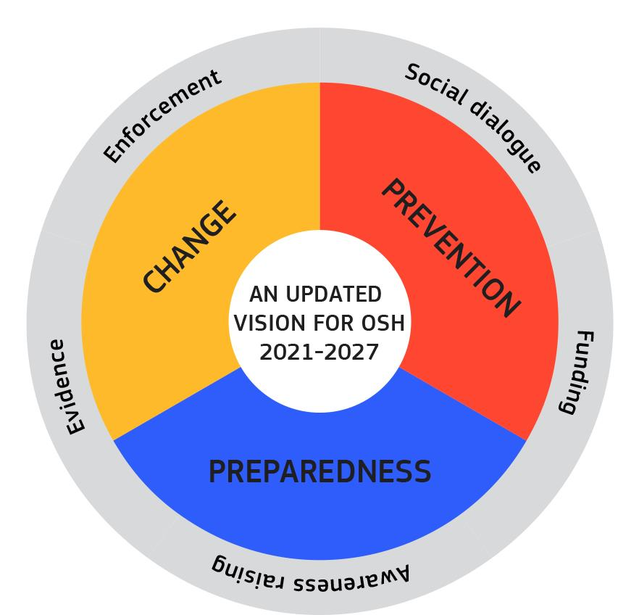
EU Strategic Framework in OHS 2021 – 2027
2. Anticipating and managing change
COM:
Legislation
Non-legislative measures
Campaining
Tools, Guidelines
GOV:
National strategies reg. green and digital transitions
Efficient labour inspection
Mental and PSR across sectors
SP:
Update industry agreements – PSRs, MSD
Focus on solutions for TW, digi, disconnect

Slide 9
2. EU-OSHA ESENER 2019 edition

Slide 10
3rd European Survey of Enterprises on New and Emerging Risks
Fieldwork: April – August 2019.
Mode: computer-assisted telephone interview (CATI).
Countries: 33.
Establishments surveyed: 45,420.
Business size: from 5 employees on.
Activity sector: all public and private, including agriculture.
Respondent: person ‘who knows best’ about safety and health in their establishment
Topics: OSH management, psychosocial risks, worker representation, drivers and barriers to OSH

Slide 11
Sample size
3rd European Survey of Enterprises on New and Emerging Risks
Country | Interviews for ESENER-3
Austria | 1,503
Belgium | 1,506
Bulgaria | 755
Croatia | 740
Cyprus | 757
Czech Republic | 1,552
Denmark | 1,513
Estonia | 758
Finland | 1,505
France | 2,251
Germany | 2,264
Greece | 1,501
Hungary | 1,504
Iceland | 753
Ireland | 750 + 1250
Italy | 2,251
Latvia | 756
Country | Interviews for ESENER-3
Lithuania | 754
Luxembourg | 773
North Macedonia | 752
Malta | 453
Netherlands | 1,521
Norway | 1,501 + 450
Poland | 2,250
Portugal | 1,493
Romania | 1,500
Serbia | 751
Slovakia | 756
Slovenia | 767 + 300
Spain | 2,266
Sweden | 1,512
Switzerland | 1,502
United Kingdom | 2,251
Total | 45,420

Slide 12
3rd European Survey of Enterprises on New and Emerging Risks
What are the main risk factors affecting workers’ safety and health in Europe?

Slide 13
Risk factors present in the establishment (% establishments, EU-28)
3rd European Survey of Enterprises on New and Emerging Risks
Base: all establishments in the EU-28.
Notes:
5% none of general OSH, 24% none of PSR

Slide 14
3rd European Survey of Enterprises on New and Emerging Risks
How are these risk factors managed at the workplace?

Slide 15

Workplace risk assessments carried out regularly, 2014-2019 (% estab.)
3rd European Survey of Enterprises on New and Emerging Risks
Base: all establishments.

Slide 16
Action plan and procedures against psychosocial risks, 2019 (% establishments)
3rd European Survey of Enterprises on New and Emerging Risks
Base: establishments with more than 19 workers.

Slide 17
3rd European Survey of Enterprises on New and Emerging Risks
What motivates enterprises
to manage risks?

Slide 18
Major reasons for addressing health and safety, 2014- 2019 (% estab., EU-28)
3rd European Survey of Enterprises on New and Emerging Risks
Base: all establishments in the EU-28.
Notes:
Results: weighted by estprop

Slide 19
Visit from labour inspectorate in the 3 years prior to the survey, 14-19 (% estab.)
3rd European Survey of Enterprises on New and Emerging Risks
Base: all establishments.
Notes:
Results: weighted by estprop

Slide 20
3rd European Survey of Enterprises on New and Emerging Risks
Why do some enterprises
not manage risks?

Slide 21
Why workplace risk assessments are not carried out regularly, 14- 19 (% estab., EU-28)
3rd European Survey of Enterprises on New and Emerging Risks
Base: establishments in the EU-28 that do not carry out risk assessments regularly.
Notes:
Results: weighted by estprop

Slide 22
Major difficulties for addressing health and safety, 2014- 2019 (% estab., EU-28)
3rd European Survey of Enterprises on New and Emerging Risks
Base: all establishments in the EU-28.
Notes:
Results: weighted by estprop

Slide 23
Legal obligations as a major difficulty in addressing H&S 14-19 (% establishments
3rd European Survey of Enterprises on New and Emerging Risks

Slide 24
Are PSRs easier or more difficult to address than other risks? 2019 (% est.)
3rd European Survey of Enterprises on New and Emerging Risks
Base: establishments in all 33 countries that report at least one psychosocial risk factor to be present in their establishments.

Slide 25
Difficulties in addressing PSRs by establishment size, 2019 (% establishments)
3rd European Survey of Enterprises on New and Emerging Risks
Base: establishments in all 33 countries that report at least one psychosocial risk factor to be present in their establishments and that consider them to be more difficult to address than others.

Slide 26
3rd European Survey of Enterprises on New and Emerging Risks
Do workers have a say
in the way safety and health is managed?

Slide 27
Forms of employee representation, 2014-2019 (% establishments, EU28)
3rd European Survey of Enterprises on New and Emerging Risks
Base: all establishments in the EU-28 – national size thresholds apply.

Slide 28
Appointment of H&S representatives, by country, 2019 (% establishments)
3rd European Survey of Enterprises on New and Emerging Risks
Base: all establishments.
Notes:
Agriculture is not displayed on the chart as there were only 8 establishments interviewed in this sector.

Slide 29
Employee involvement in measures to address PSRs risks, by country (% est.)
3rd European Survey of Enterprises on New and Emerging Risks
Base: establishments that report at least one measure to address psychosocial risks.

Slide 30
Back to EU OHS Strategic Framework 21-27

Slide 31
Few suggestions for trade unions
Mobilize workers and generally public in process of humanization of work in all employment areas including vulnerable groups of workers
Prioritize OHS in own agenda and demand addressing of main issues through clear action plans and deadlines by EC
Be involved in crucial discussion on implementation of SF in different areas including all monitoring projects
Increase involvement in working on strategies on national and sectoral level
Use opportunities given by the Strategic Framework including funding schemes

Slide 32
THANK YOU!
vkempa@etui.org

Slide 33

12.30 - 13.30
Refreshment Break

Slide 34
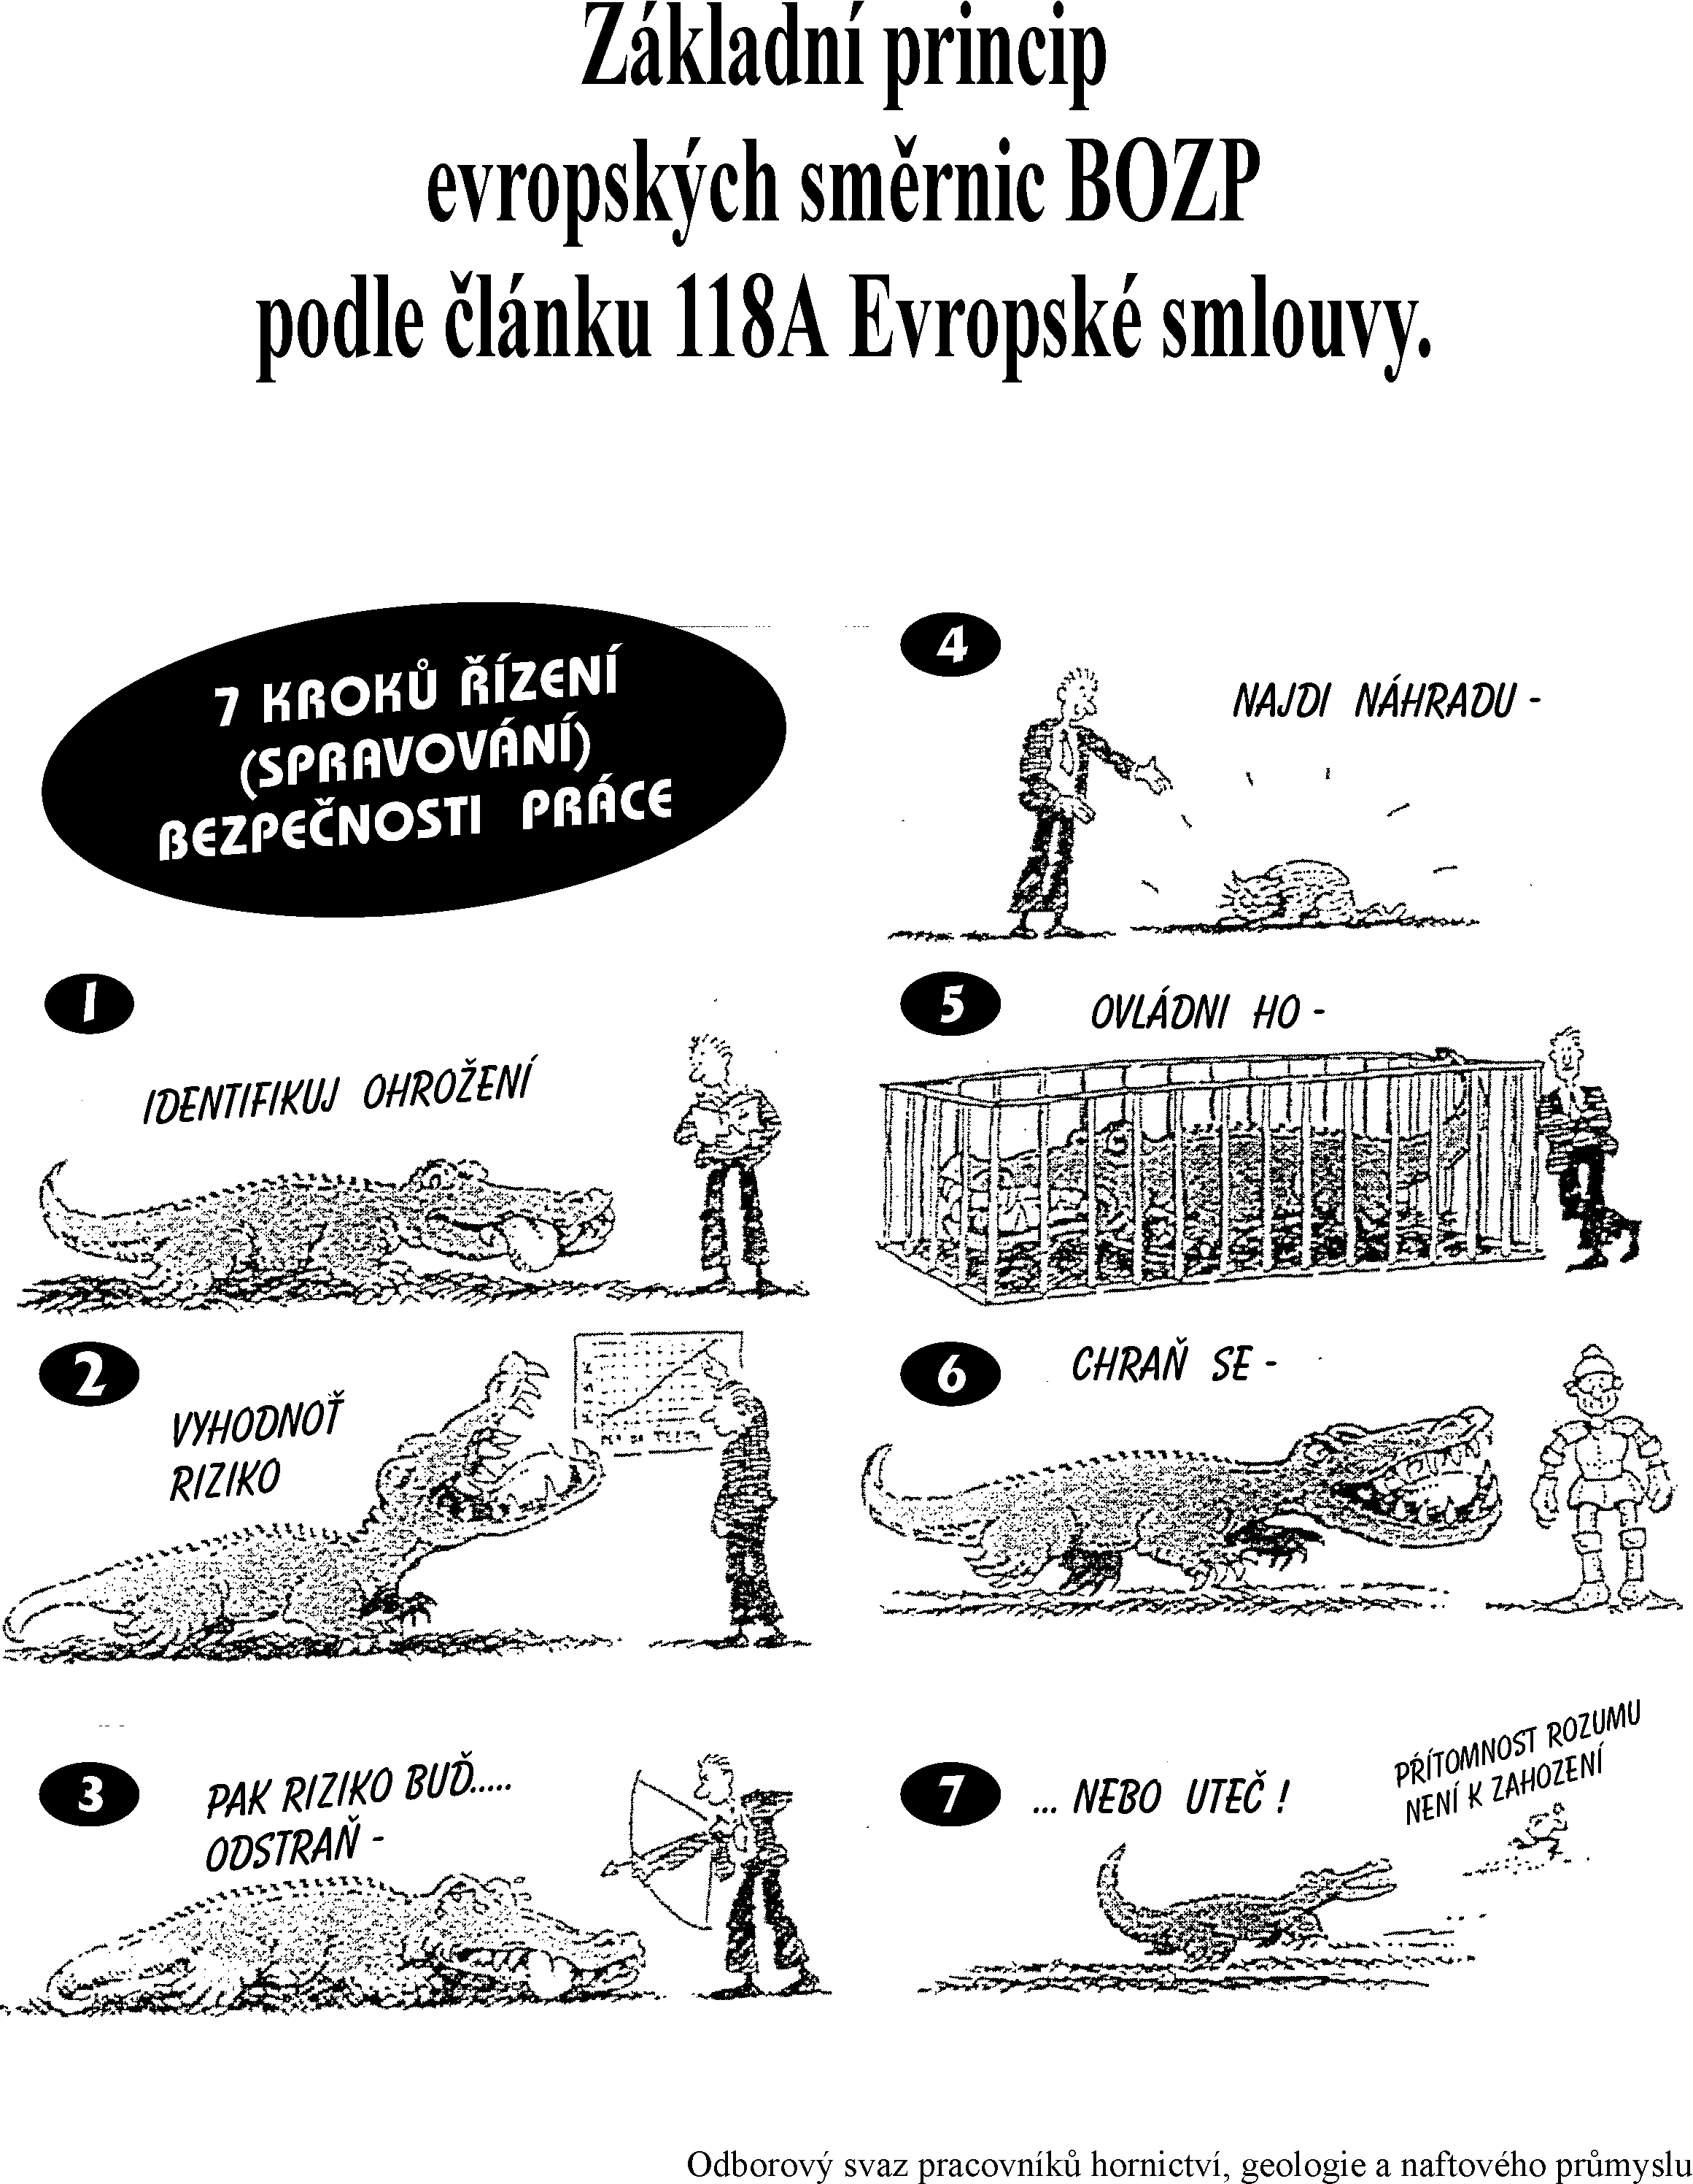
Prevention Principles
Find a substitution
Control the risk
Identify hazard
Protect yourself
Evaluate the risk
Eliminate
the risk
OR ESCAPE!

Slide 35
Co-operation of all the actors in the area of prevention
Coll. & other
agreements
Written Form
Education
Funds
Enforcement
Role of the state
Systematic
H&S
Management
Democracy
SOCIAL
DIALOGUE
&
CO-OPERATION
Research
Resources
Partnership
Independency
Co-ordination
Promotion
Media
Avareness
Workers
Reps
New Forms

Slide 36
VISION ZERO

Slide 37
VISION ZERO
7 Golden Rules for VISION ZERO at Enterprise Level
1 Take leadership – demonstrate commitment
2 Identify hazards – control risks
3 Define targets – develop programmes
4 Ensure a safe and healthy system – be well-organized
5 Ensure H&S in machines, equipment and workplaces
6 Improve qualifications – develop competence
7 Invest in people – motivate by participation

